Slide 1





ProjectTitle– Al-PoweredNAACAccreditationAssistant
Domain of Project –
Education
St udent N am e | R_{P}e_{h}c_{o}e_{t}n_{o}t Passport | Email ID | [M_{W}o_{h}bi_{a}le_{ts}n_{A}u_{p}m_{p}b]er
Sakshi Sanjay Chimukale |  | sakshic2906@gmail.com | 8237942906

Slide 2

AI-Powgígd NAAC Accígdit3tion Assist3nt
A RAG-based intelligent agent designed to empower faculty with precise, context-aware support throughout the NAAC accreditation process.
PROBLEM STATEMENT NO. 3

Slide 3

The Accíeditation Challenge
NAAC accreditation demands extensive documentation, strict compliance, and deep institutional knowledge. Faculty spend significant time on
repetitive tasks — generating SSR drafts, compiling criteria-wise inputs, and documenting best practices — often without structured, context-aware guidance.

Slide 4

Wk3t Is RA“?
Rgtíigv3l-AugÉgntgd “gngí3tion
RAG combines a retrieval system with a generative AI model. It first fetches relevant documents from trusted sources, then uses those sources to generate accurate, grounded responses — eliminating hallucinations and ensuring
institutional context is always reflected.

Slide 5

How tkg AI Aggnt Woíks
F3cultQ QugíQ
Rgtíigvg D3t3
“gngí3tg Rgsponsg
Dglivgí SSR Dí3rts
The agent retrieves past reports, NAAC guidelines, and institutional data to produce precise, tailored outputs — streamlining documentation and reducing manual effort.

Slide 6

Coíg C3p3bilitigs
SSR Dí3rt “gngí3tion
Auto-generate Self-Assessment Report drafts aligned to NAAC criteria.
Cíitgíi3-Wisg Inputs
Provide structured, criterion-specific guidance for each NAAC parameter.
Bgst Pí3cticg Docs
Document and format institutional best practices with compliance-ready structure.

Slide 7
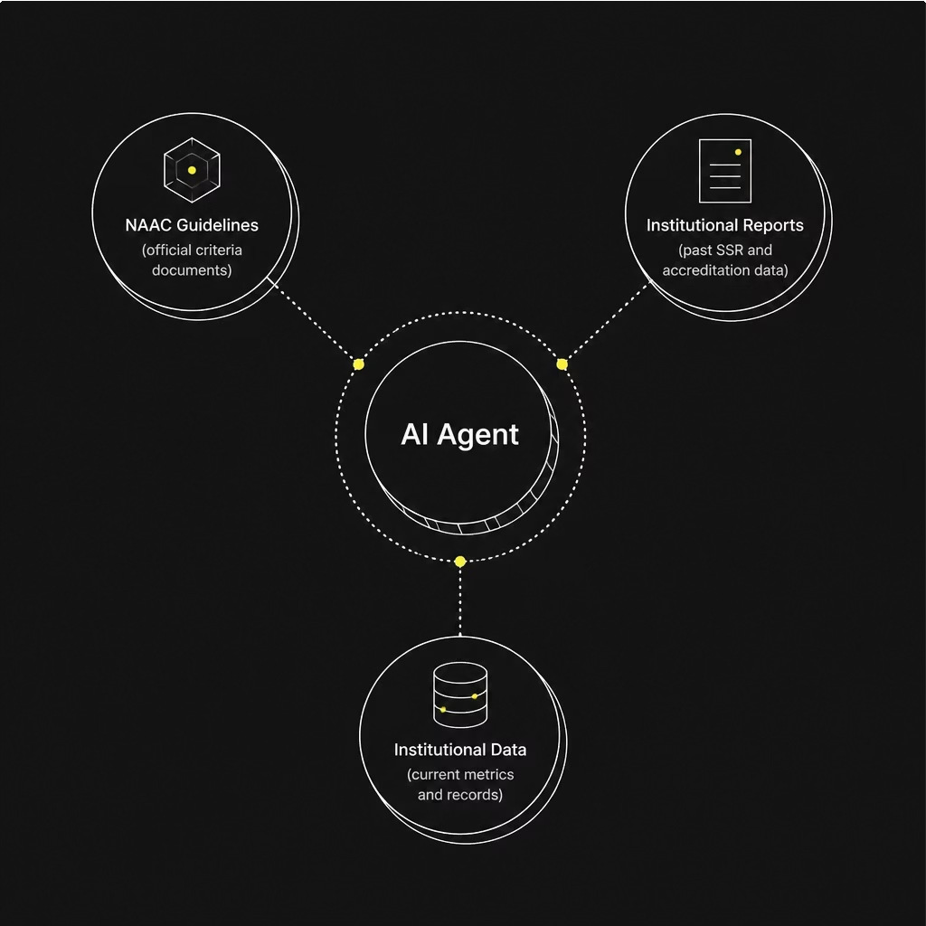
Tíustgd, “íoundgd Answgís
Souícg-“íoundgd Intglliggncg
Unlike generic AI chatbots, this agent's responses are always anchored to:
Official NAAC guidelines and criteria documents Institutional past accreditation reports
Verified institutional data repositories
This ensures accuracy, compliance, and auditability at every step.

Slide 8



Impact on Faculty Woíkflow
Reduced Time on Repetitive Tasks
Automates documentation workflows, freeing faculty to focus on quality improvement.
Enhanced Accuíacy
Context-aware responses reduce errors and ensure NAAC compliance.
Empoweíed Faculty
Faculty gain confident, guided support throughout the accreditation journey.

Slide 9

Technology Stack
IBM Cloud Ḻitg Sgívicgs
Scalable, enterprise-grade cloud infrastructure for deployment and data management.
IBM “í3nitg
IBM's purpose-built foundation model for enterprise AI — ensuring security, reliability, and domain-specific performance for the RAG pipeline.
Mandatory Requirement: Use of IBM Cloud Lite Services and IBM Granite is required for this solution.

Slide 10
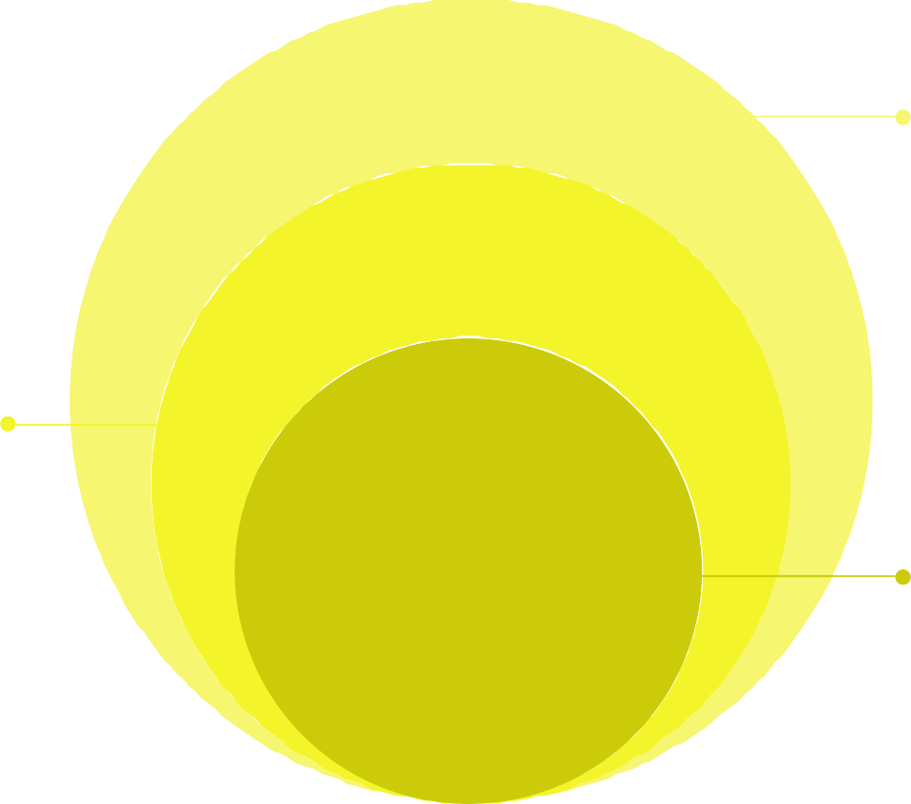
End-to-End Aíckitgctuíg
F3cultQ Intgír3cg
SSR drafts, criteria inputs, best-practice documents
RA“ Enging
IBM Granite with IBM Cloud retrieval-augmented
generation
D3t3 Ḻ3Qgí
Institutional DB, NAAC guidelines, past reports
The architecture layers trusted data sources through IBM's RAG engine to deliver a seamless faculty-facing interface for all accreditation documentation needs.

Slide 11

Key Takeaways
1
RA“-Powgígd Pígcision
Grounded in institutional data and NAAC guidelines — no hallucinations, full compliance.
2
F3cultQ Empowgímgnt
Automates SSR drafts, criteria inputs, and best practice documentation to reduce repetitive workload.
3
IBM-B3ckgd Inrí3stíuctuíg
Built on IBM Cloud Lite and IBM Granite for enterprise-grade security and reliability.

Slide 12
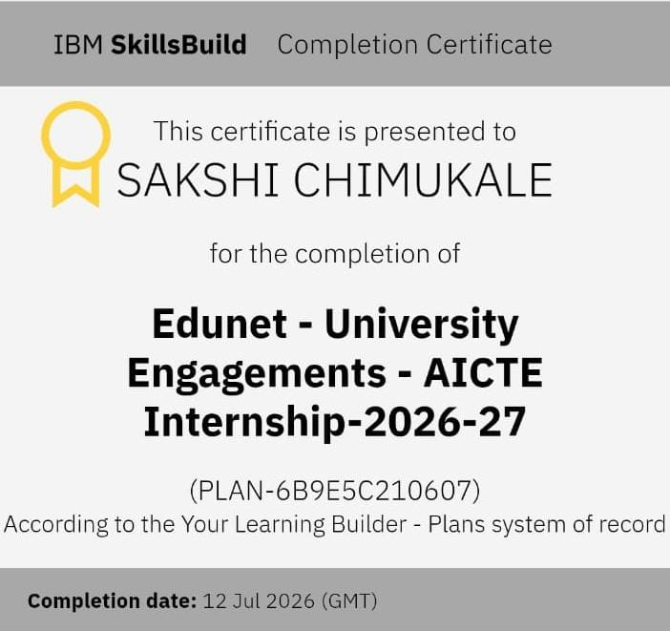

Slide 13
